Slide 1

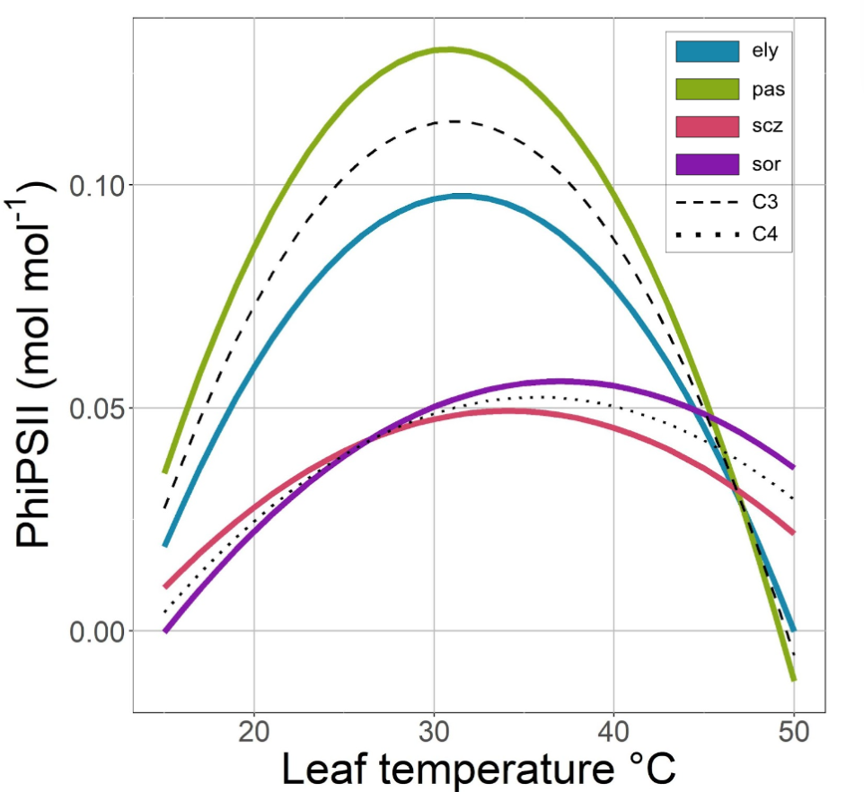
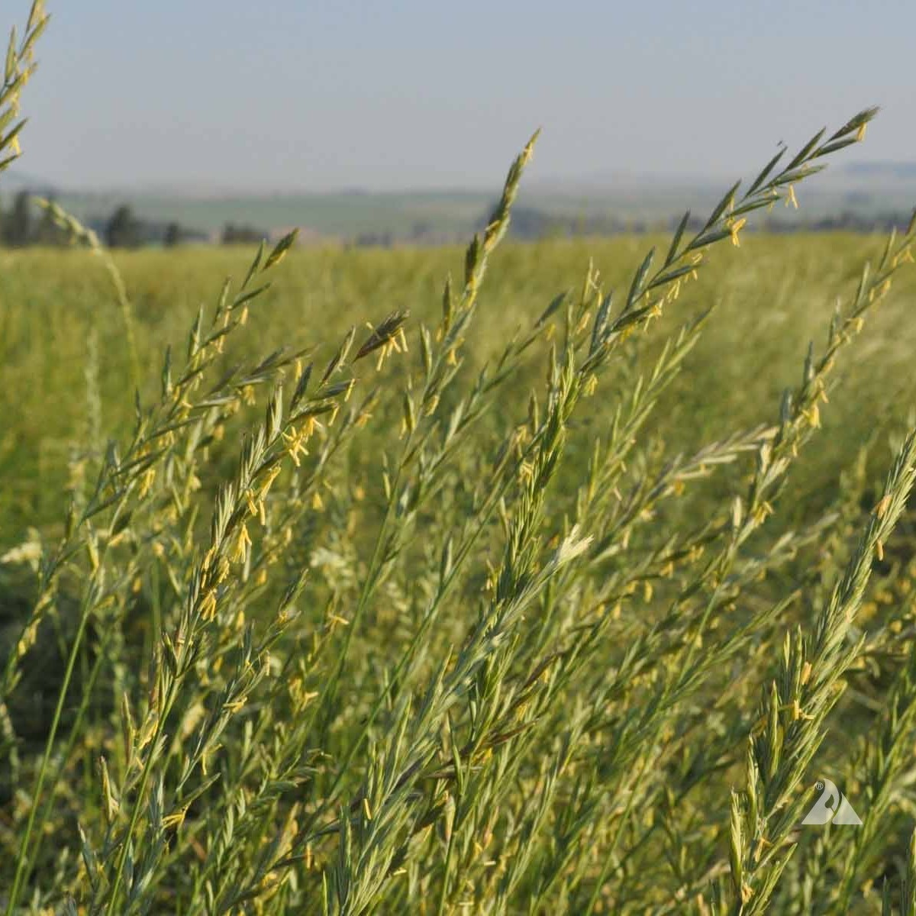
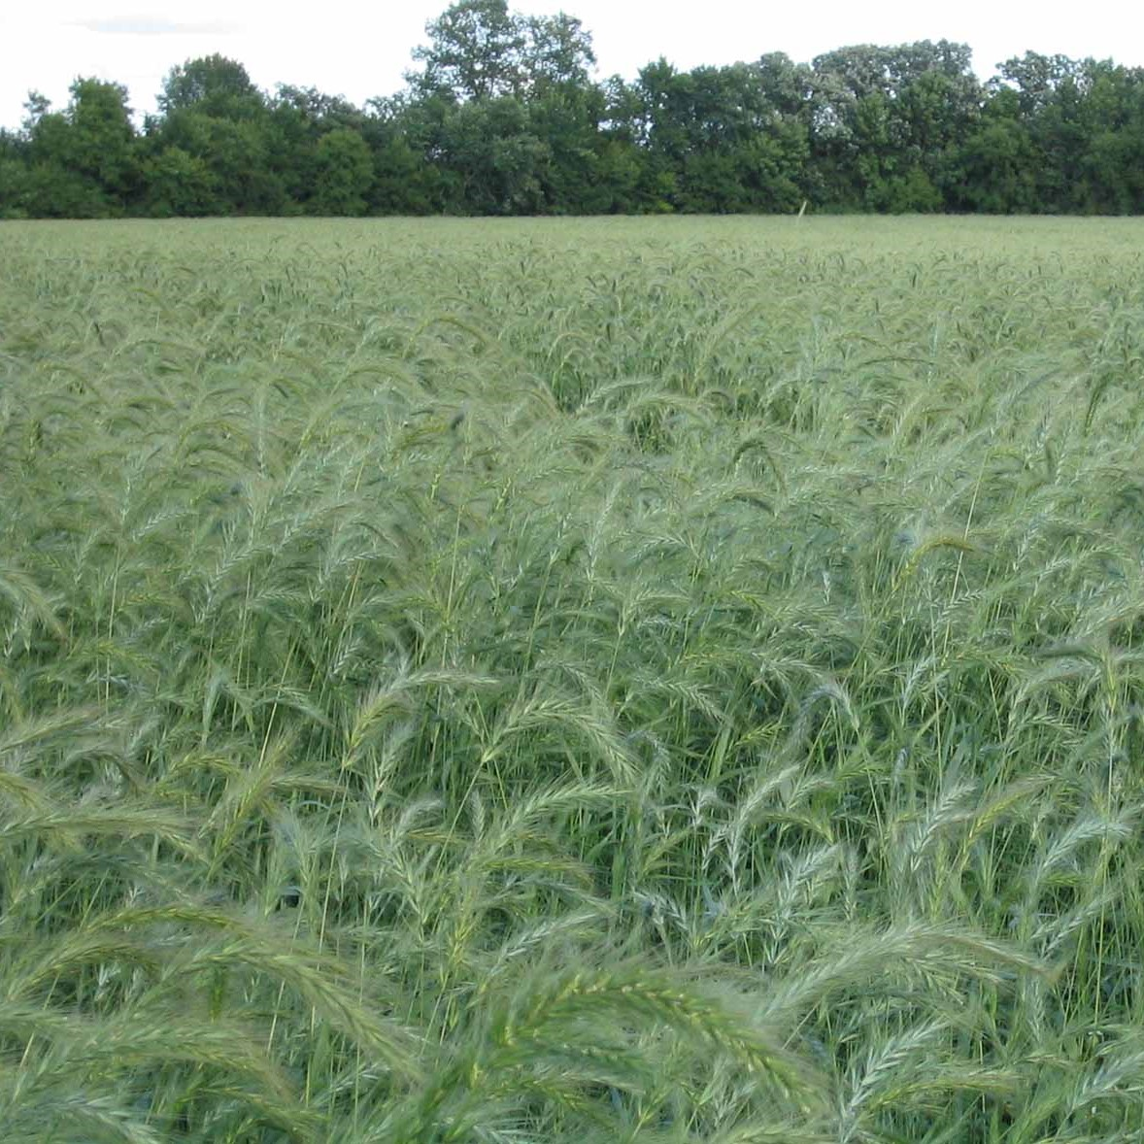
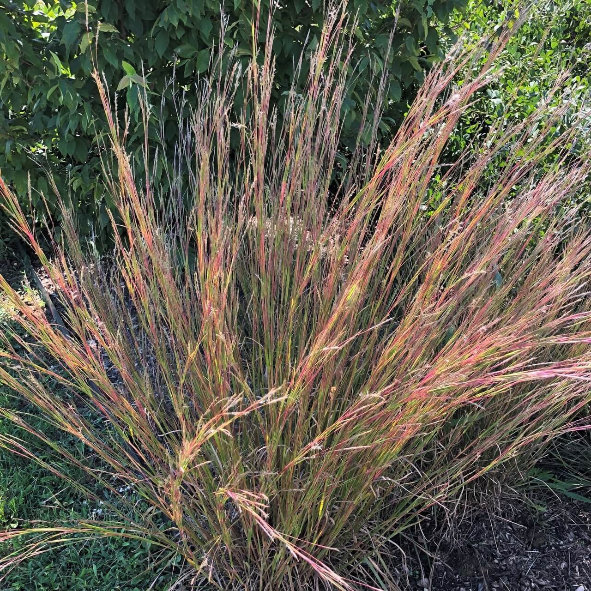
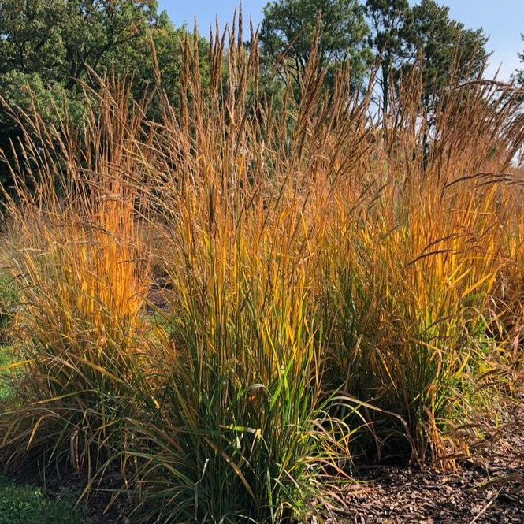

Temperature response of photosystem II quantum efficiency in C₃ versus C₄ grasses
The 𝚽PSII Temperature Response is Different for C₄ species than C₃
Garrison Garza¹, Nicholas G. Smith¹
¹Department of Biological Sciences, Texas Tech University, Lubbock TX
INTRODUCTION
HYPOTHESIS
Global temperatures are rising from excessive CO₂ emissions
Terrestrial photosynthesis offsets 30% of human CO₂ emissions
Chlorophyll fluorescence can measure photosynthetic efficiency (𝚽PSII)
What are the differences in temperature responses of 𝚽PSII between C₃ and C₄ photosynthesis in different species of grasses?
Temperature Optimum of C₄ > C₃
Optimal Temperature Range of C₄ > C₃
𝚽PSII at T-Opt of C₄ > C₃
Analysis performed in R
Temperature response curves fitted for each plant
Data from individual curves were pulled to fit overall photosynthetic species and pathway curves
)
Hypothesis 1: TRUE
Temperature Optimum of C₄ is significantly higher than C₃ (P< 0.001)
METHODS
IMPACTS
40 Plants grown over 12 weeks
4 Species, 2 C₃ and 2 C₄
𝚽PSII measurements taken at 18°C, 24 °C, 30 °C, 36°C, 42°C, and 48°C
By better understanding plant photosynthesis, we can…
Create more accurate climate models
Improve agricultural efficiency
Increase global carbon flux
Hypothesis 2: TRUE
Breadth of C₄ Temperature Response curve is significantly higher than C₃ (P< 0.001)
Pascopyrum smithii (C₃)
Elymus canadensis (C₃)
Hypothesis 3: FALSE
𝚽PSII at T-Opt of C₄ is significantly lower than C₃ (P< 0.001)
CONTACT ME
garrgarz@ttu.edu
Schizachyrium scoparium (C₄)
Sorghastrum nutans (C₄)

